Slide 1
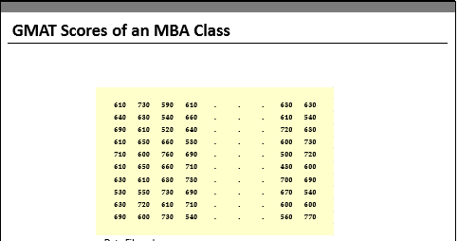
Visualization Techniques

Slide 2
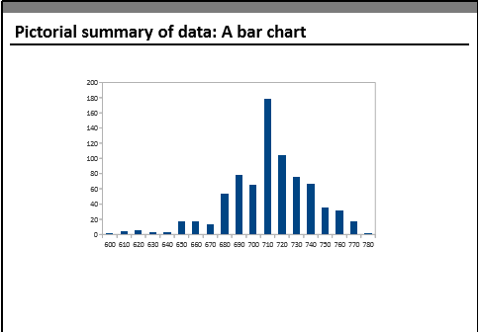

Slide 3
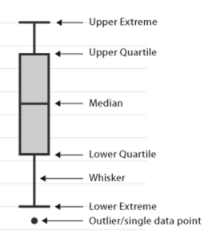
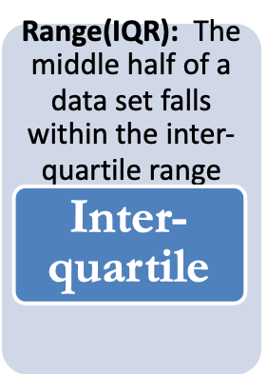

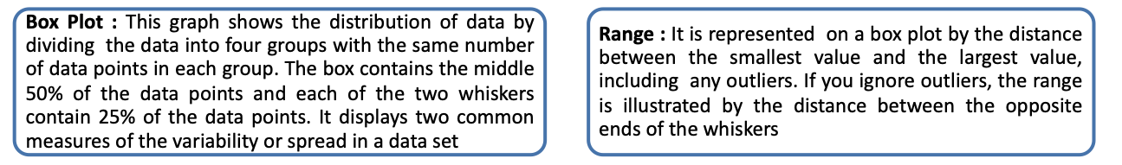
Graphical Techniques – Box Plot

Slide 4
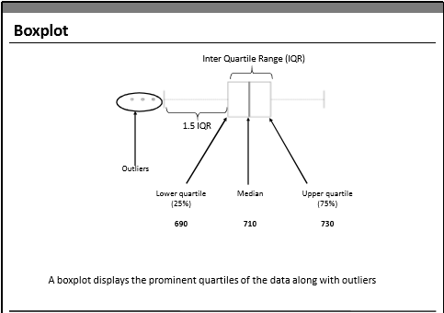

Slide 5
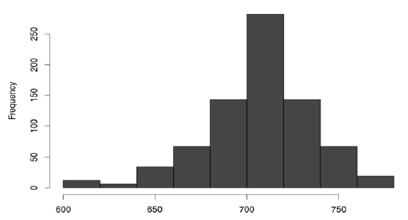
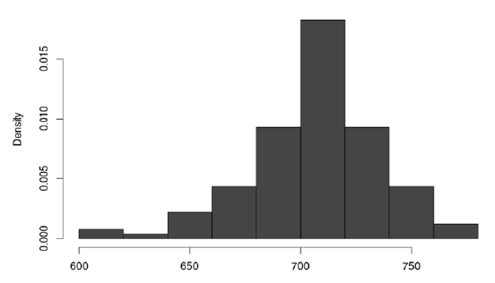
Graphical Techniques – Histogram
A Histogram Represents the frequency distribution, i.e., how many observations take the value within a certain interval.

Slide 6
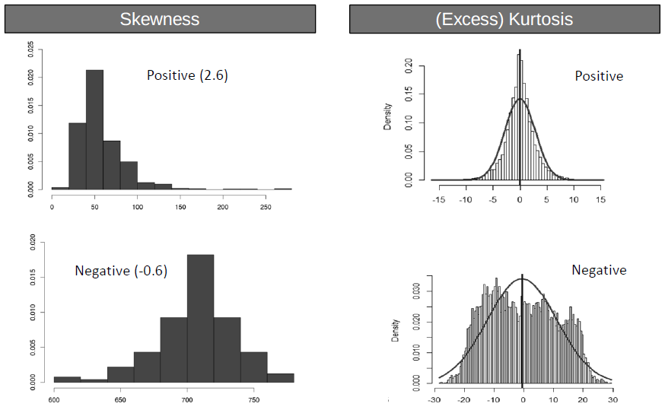
Skewness & Kurtosis
Third and Fourth moments
Skewness Kurtosis
A measure of asymmetry in the distribution
Mathematically it is given by
E[(x-µ/σ)]³
Negative skewness implies mass of the
distribution is concentrated on the
right
A measure of the “Peakedness” of
the distribution
Mathematically it is given by
E[(x-µ/σ)]⁴ -3
For Symmetric distributions, negative
kurtosis implies wider peak and thinner
tails

